Slide 1
Welcome to CSAMA 2019 (16th edition)
Morning lectures
Coffee break
12.00-13.30 Lunch
Installation helpdesk
Afternoon Labs
Flashlight tasks (@Mike)
Coffee break
Sports and Leisure
Dinner
Evening sessions
Social event / expedition into the mountains

Slide 2
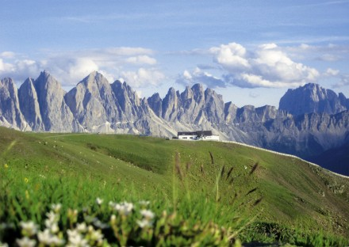
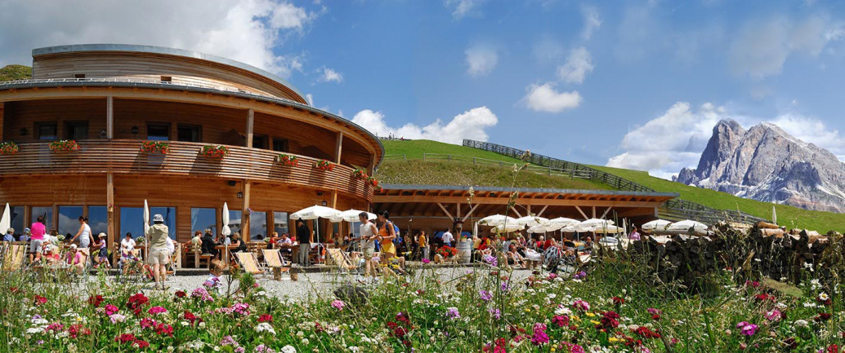
CSAMA Social Programme
Wednesday 24th July 2019
Mount Plose
Rossalm (2164m)

Slide 3
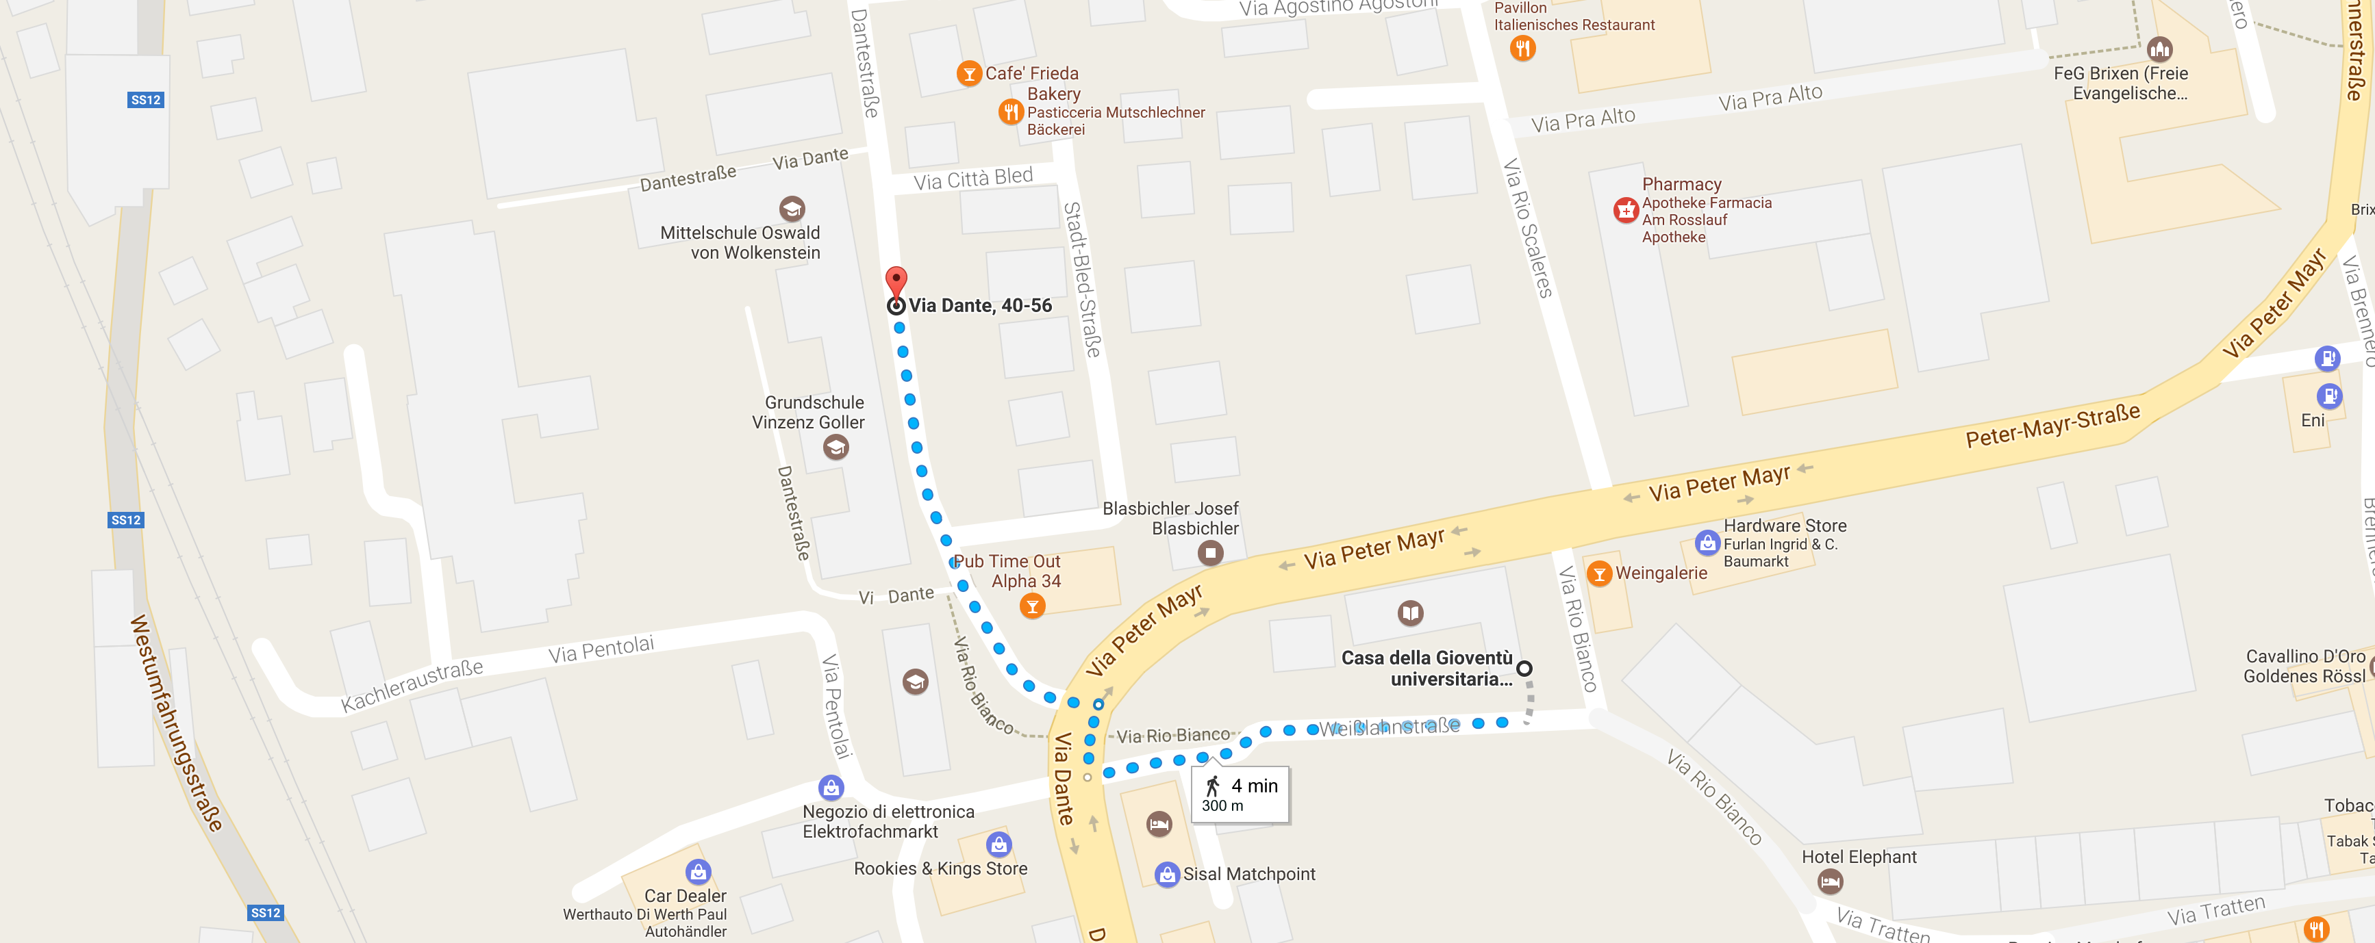
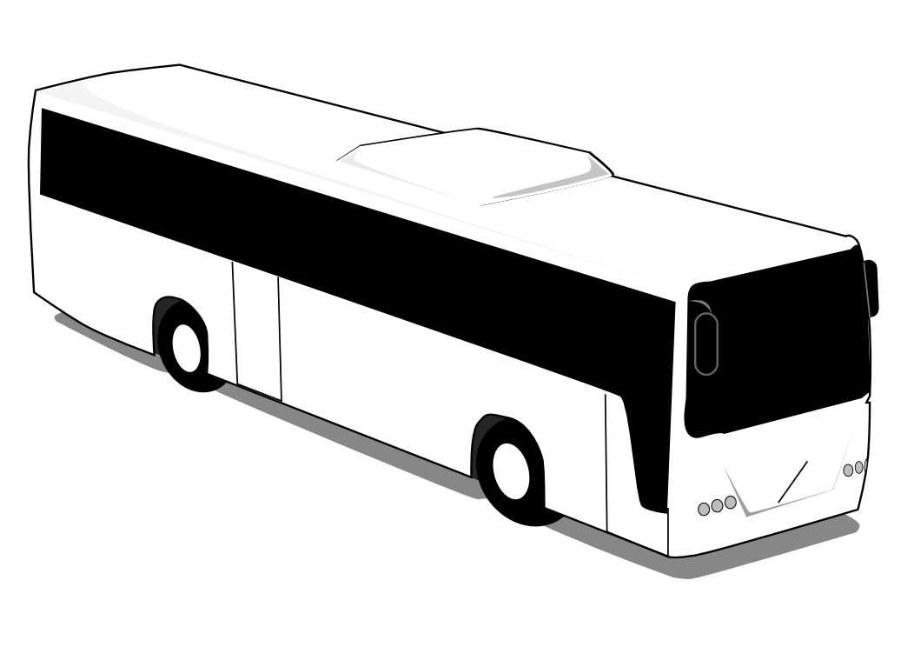
CSAMA Social Programme – Timeline
2:50 pm We meet at “Casa della Gioventù” and walk 1 min to the bus waiting for us in Via Dante.
Please take the underpass to cross “Via Peter Mayr.”

Slide 4
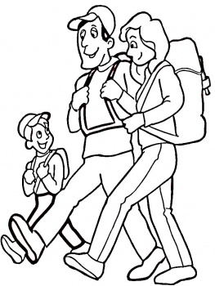
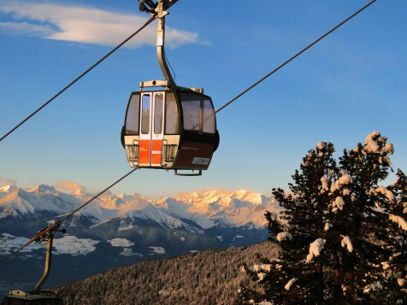
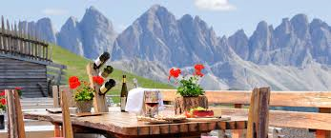
CSAMA Social Programme – Timeline
3:00 pm The bus leaves towards the cable car station for Mount Plose.
3:30 pm The cable car takes us to the top of Mount Plose in about 20-30 min.
45-60 min Hiking to Rossalm at 2200 m altitude.
6:00 pm Dinner at Rossalm.
8:00 pm Time to leave! We walk back to the bus from Rossalm (~1h).
9:00 pm The bus takes us back to Brixen.

Slide 5
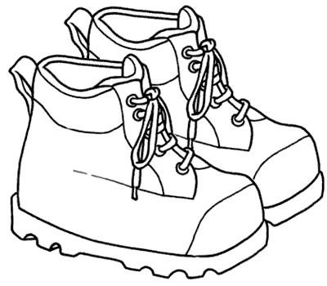
Please pack/bring:
Solid footwear (hiking shoes or boots)
Jacket or warm sweater, scarf (it may get quite fresh)
Please note: If you will not attend the social programme, please let us know at the latest on Monday 22 July via email to simone.bell@embl.de

